Slide 1


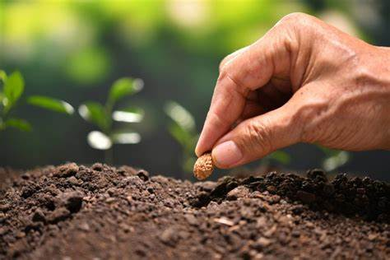
Change
Exercise Schedule
Exercise Record
No-Phone Record
Cause
Videos
Settings

Slide 2
Login Screen
Login with Google Authentication
Login with Microsoft
Login with Apple Id

Slide 3
Exercise Schedule

Slide 4
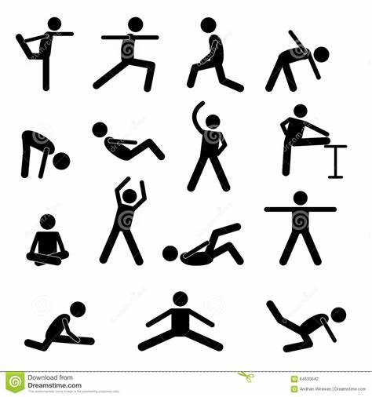
Exercise Record
Logo
06/11/2022-Cycling-35mins
05/11/2022-swimming 60 mins-1 seed planted!
Fill your exercise record by exercising more! Remember one hour means 1 seed planted!

Slide 5
Phone Record
13/11/2022-49 mins
12/11/2022-1hr-1 seed planted
Text-Input-Record

Slide 6
Cause
The purpose of this app is to motivate people to get healthier and spend more time out of their devices. This app does this with the Exercise Record and No-Phone Record. A problem in the world today is deforestation-too many trees are getting cut down and with this app, we are solving two major problems in the world today.

Slide 7
Videos
Exercises
Exercises
Yoga-
Cardio-
Spinning-
Running-
Swimming-
HIIT-

Slide 8
Profile
Bio-
Favourite Exercise-
How many Seeds Planted-

Slide 9
Drawer Navigation
Exercise Schedule
Exercise Record
No-Phone Record
Profile
Logout

